Slide 1
Project 1 Ranking the opinion leader
第三組
D10115015 張宗銓
D10107502 黃崇閔
M10315020 洪稟凱

Slide 2
Method
Fetch data from Elasticsearch and filter out each post with hashtag
Formalize user-to-hashtag binary matrix and serialize to tsv file
Formalize user-to-user proximity matrix and serialize to tsv file
Calculate user’s page rank by using networkx and sorting result
Notes:
這裡說明

Slide 3
All user page rank

Slide 4
Top 10 user page rank

Slide 5
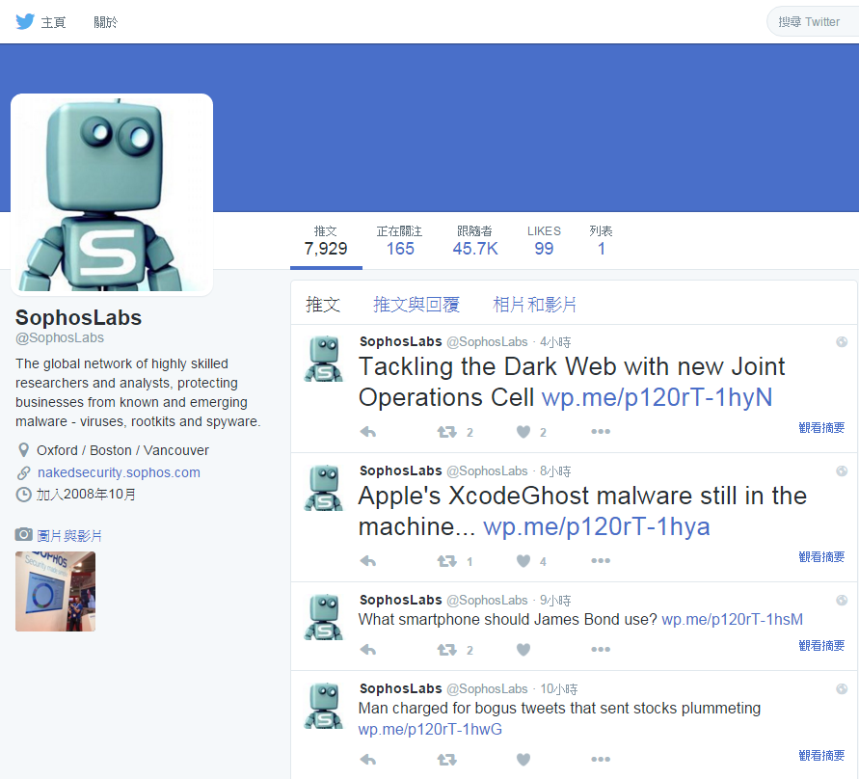
Top 1 user profile

Slide 6
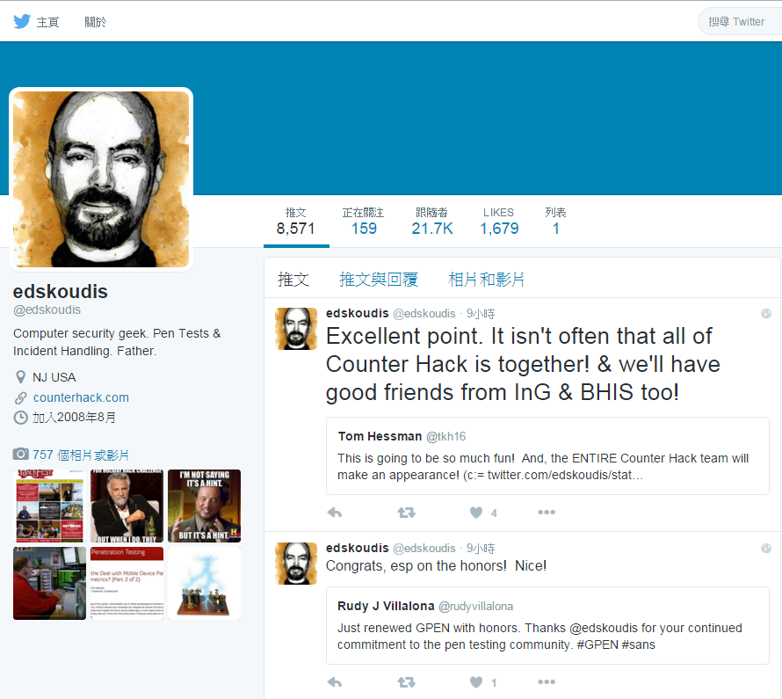
Top 2 user profile

